Slide 1



Instacart Market Analysis + Business Initiatives
Miguel Grisanti
January 2020

Slide 2
Overview
Background: Instacart
User Classification
Segmentation
Market Basket
Takeaways + Initiatives

Slide 3
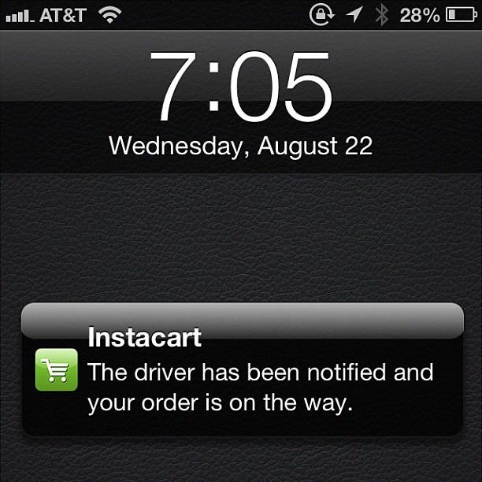
Background
Same-day grocery delivery founded in 2012
Delivers from over 20,000 stores across US and Canada
Connects consumers with personal shoppers
Leading grocery delivery market share with 59% of share
Notes:
Less wording, under a minute to go through
It’s about the data not instacart

Slide 4
Dataset
https://www.kaggle.com/c/instacart-market-basket-analysis/data
3M orders
200K users
50K products
Notes:
Potentially add to appendix.

Slide 5
User Classification
Small Businesses
Retail,
Food and beverage,
Service Industry
< 3.5 days
> 60 orders
Offices
Corporate,
Non-corporate,
co-working spaces
> 3.5 days
> 60 orders
Active
Head of households, housewives,
Individuals
< 30 days
< 60 orders
Inactive
Trials,
First timers,
Special occasions
> 30 days
< 60 orders
Notes:
Move further back in the presentation

Slide 6
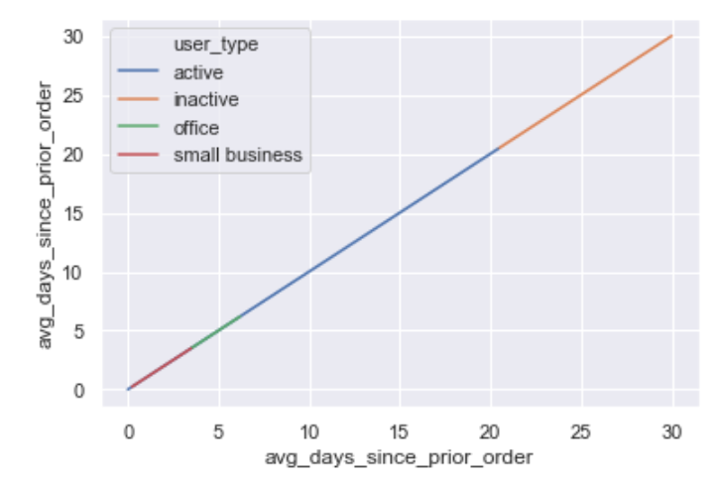
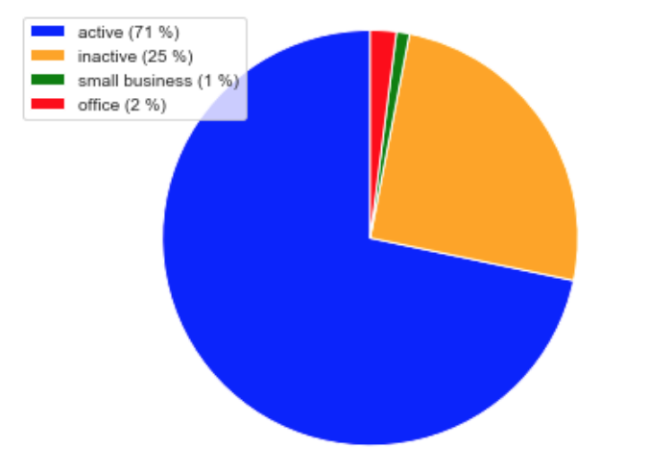
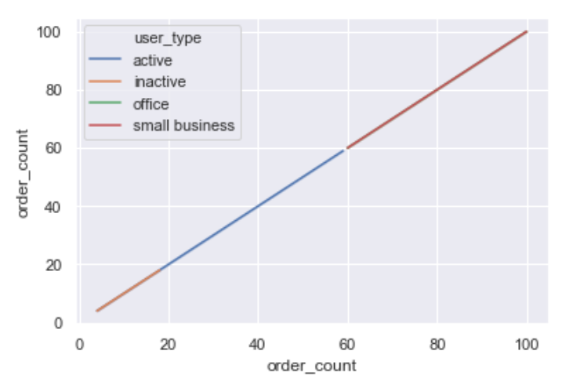
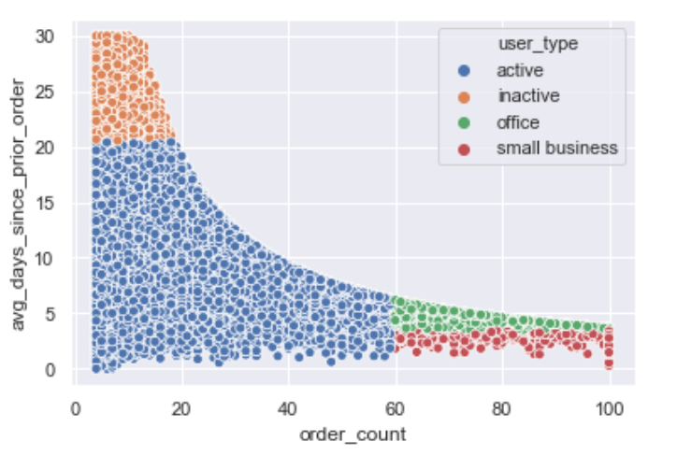
Segmentation
Notes:
How to capitalize on produce orders?
Add graph towards end (maybe)

Slide 7
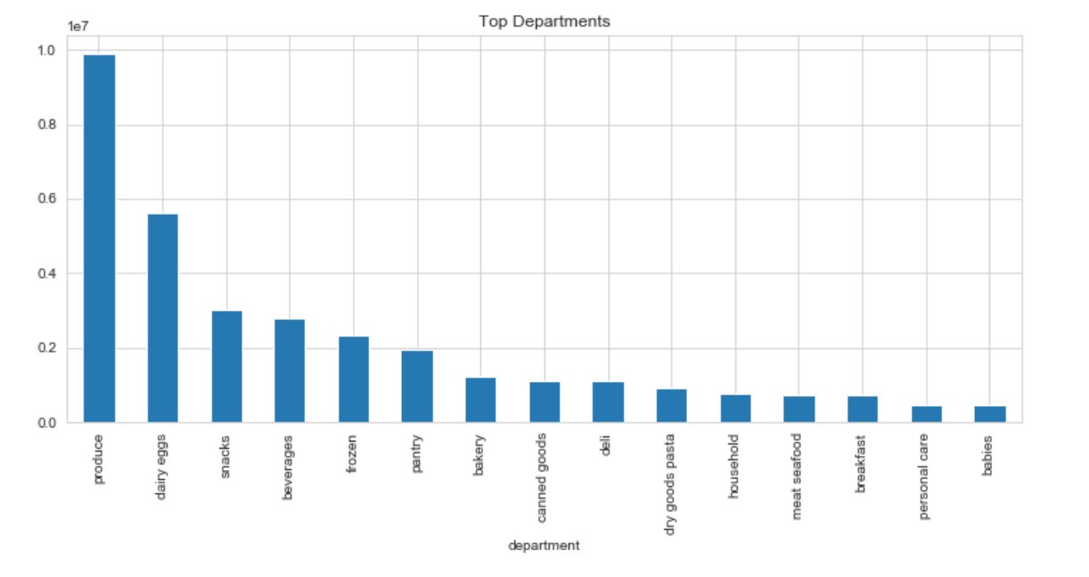
Basket Analysis

Slide 8
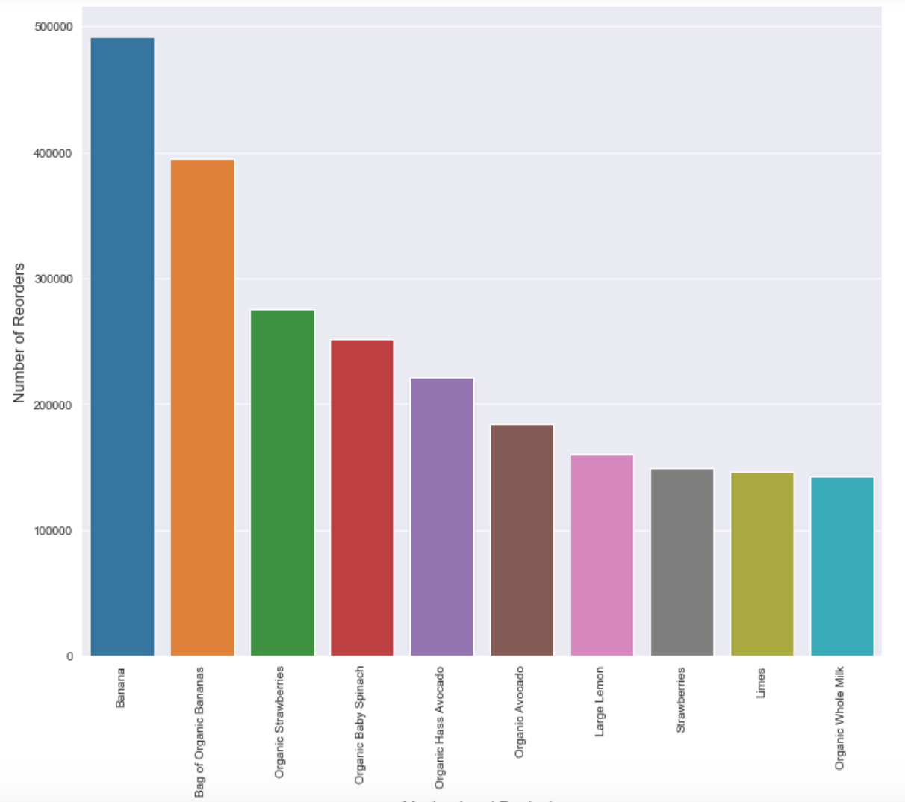
Products

Slide 9
Takeaways + Initiatives
With a large customer base, conversion of inactive users and retention of active through marketing initiatives is a priority
Retail Capsule: Brand awareness and customer acquisition
Ability to cater to our business sector with high potential for growth
Business Department: Feature engineering, security measures, and product consistency
Focus on produce department, as we can predict it is most consistently ordered
Local Focus: Reinforcing share, and uplifting our mission

Slide 10
Let’s stay in touch
https://www.linkedin.com/in/miguelsgrisantim/
miguelsgrisantim@gmail.com
917.855.5606

